Slide 1

TARGET FOLDER
TRMATGT004
TROMSØ Airfield, REDLAND
SECRET - DCS WORLD
REL TO COALITION
SECRET - DCS WORLD
REL TO COALITION

Slide 2
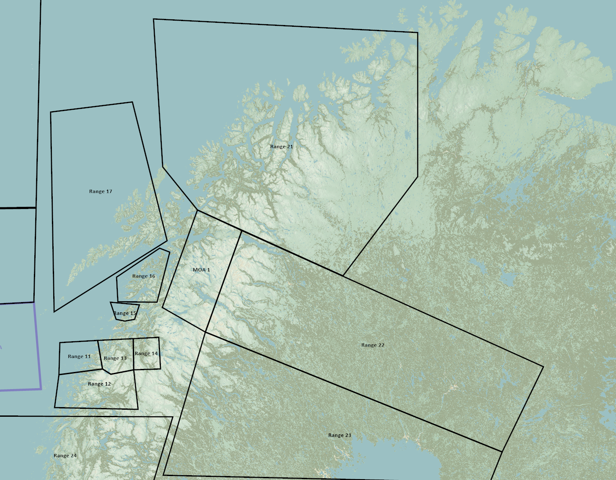
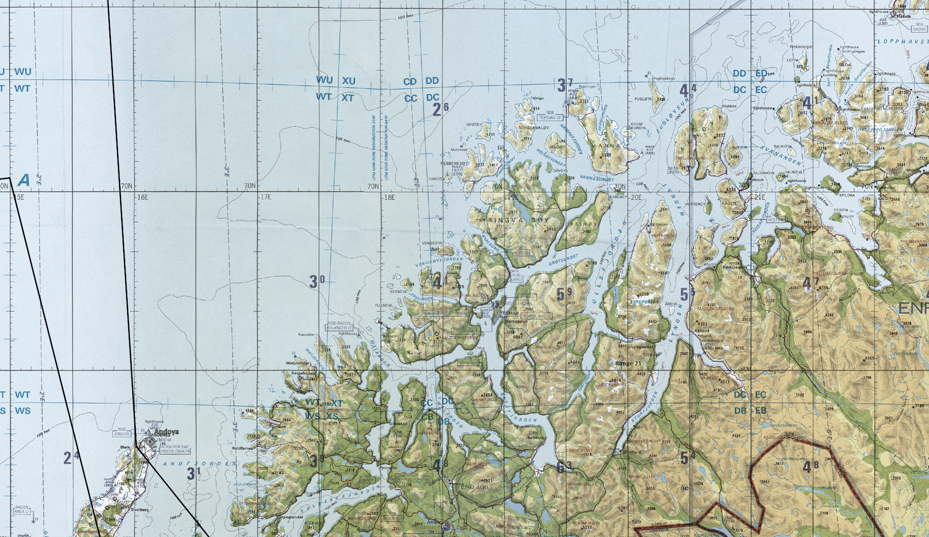
BE: SRNTGT101 CATCODE: 54
MIDB GEO: N 69 03.636 E 033 26.451
ICOD: 05JAN2024 DOI:05JAN2024
TROMSØ Airfield, REDLAND
TRMA CLASSIFIED
REL TO 132nd
JOINT OPERATIONS GRAPHIC 1/1
MAP
OVERVIEW
BE: TRMATGT004 CATCODE: 3
MIDB GEO: N69˚40.800 E018˚55.800
ICOD: 2011-JUL-06 DOI:2011-JUL-06
DECL ON: 2061-JUL-06
N
TROMSØ Airfield
TRMATGT004
.

Slide 3
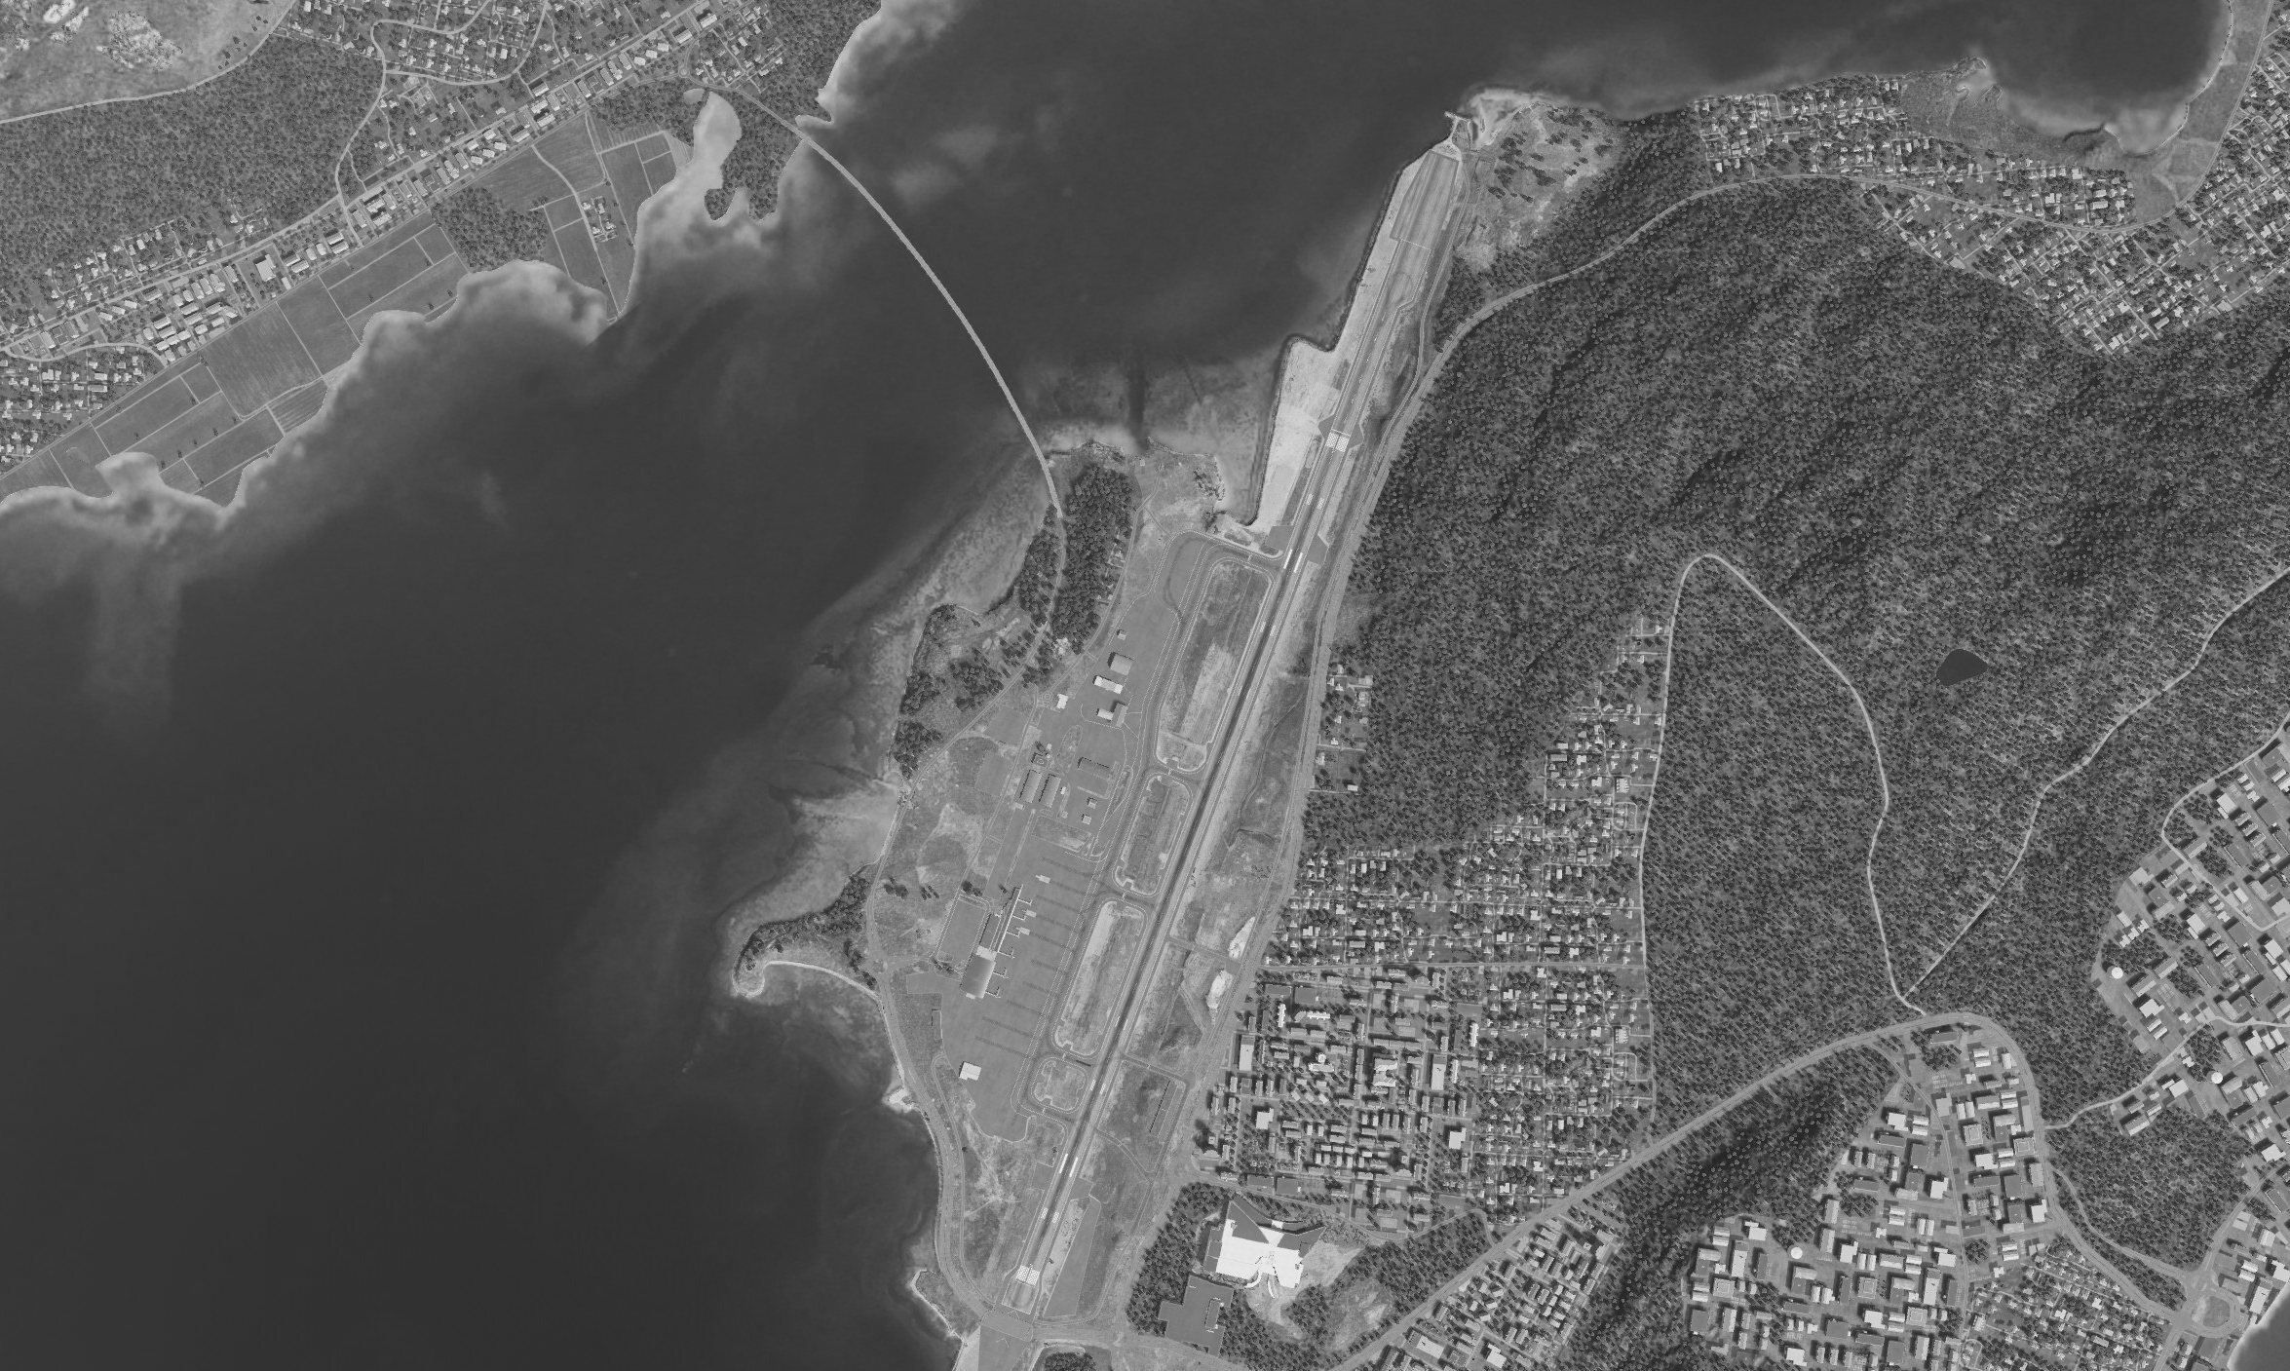
BE: SRNTGT101 CATCODE: 54
MIDB GEO: N 69 03.636 E 033 26.451
ICOD: 05JAN2024 DOI:05JAN2024
TROMSØ Airfield, REDLAND
TRMA CLASSIFIED
REL TO 132nd
FACILITY OUTLINE GRAPHIC 1/1
MAP
OVERVIEW
BE: TRMATGT004 CATCODE: 3
MIDB GEO: N69˚40.800 E018˚55.800
ICOD: 2011-JUL-06 DOI:2011-JUL-06
DECL ON: 2061-JUL-06
N
TROMSØ Airfield
TRMATGT004

Slide 4
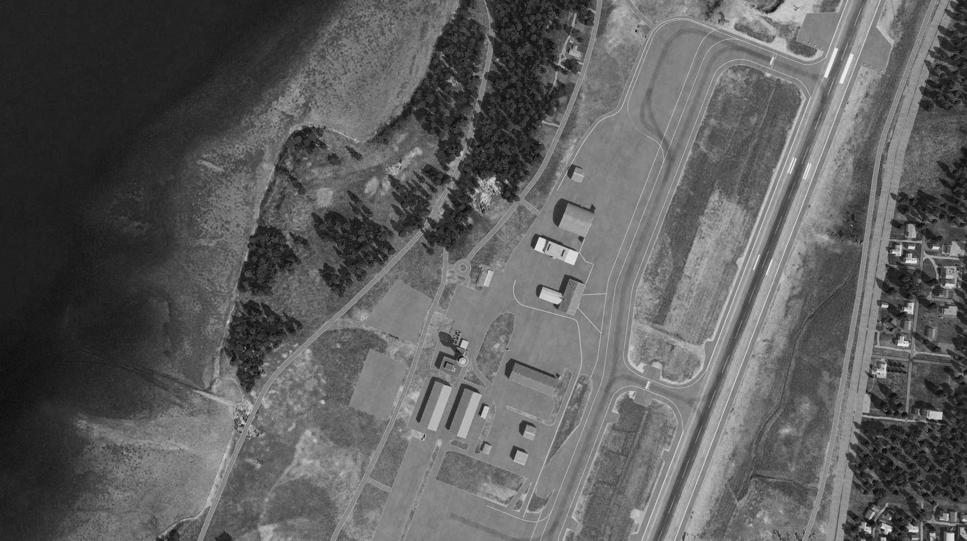
BE: SRNTGT101 CATCODE: 54
MIDB GEO: N 69 03.636 E 033 26.451
ICOD: 05JAN2024 DOI:05JAN2024
TROMSØ Airfield, REDLAND
OPAC CLASSIFIED
REL TO CJTF-23
DESIRED POINT OF IMPACT GRAPHIC 1/1
MAP
OVERVIEW
BE: TRMATGT004 CATCODE: 3
MIDB GEO: N69˚40.800 E018˚55.800
ICOD: 2011-JUL-06 DOI:2011-JUL-06
DECL ON: 2061-JUL-06
DPI: B
SQUADRON BUILDING
N69 41.086 E018 54.737
DPI MSL:21FT
N
DPI: A
INTELLIGENCE OFFICE
N69 41.060 E018 54.587
DPI MSL:22FT
DPI: C
RUNWAY
N69 41.244 E018 55.294
DPI MSL: 18 FT
DPI: D
RUNWAY
N69 50.981 E018 55.117
DPI MSL: 22 FT

Slide 5
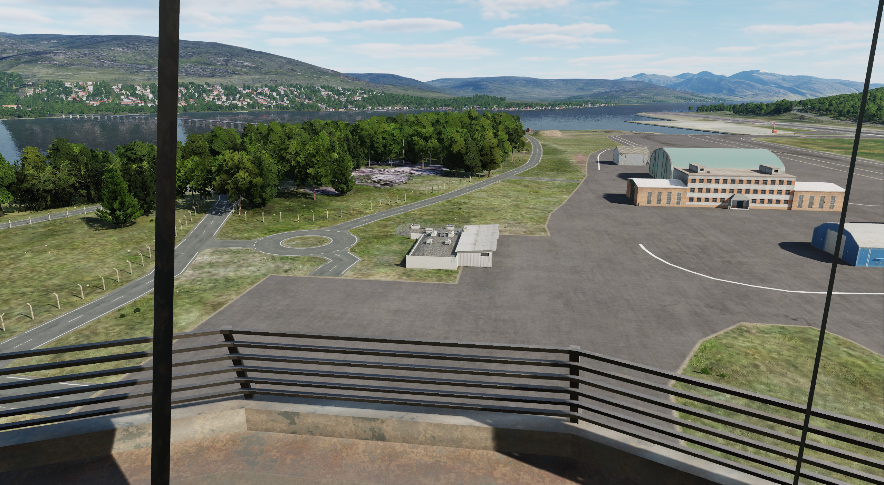
BE: SRNTGT101 CATCODE: 54
MIDB GEO: N 69 03.636 E 033 26.451
ICOD: 05JAN2024 DOI:05JAN2024
TROMSØ Airfield, REDLAND
OPAC CLASSIFIED
REL TO CJTF-23
DESIRED POINT OF IMPACT GRAPHIC 1/1
MAP
OVERVIEW
BE: TRMATGT004 CATCODE: 3
MIDB GEO: N69˚40.800 E018˚55.800
ICOD: 2011-JUL-06 DOI:2011-JUL-06
DECL ON: 2061-JUL-06
DPI: B
SQUADRON BUILDING
N69 41.086 E018 54.737
DPI MSL:21FT
N
DPI: A
INTELLIGENCE OFFICE
N69 41.060 E018 54.587
DPI MSL:22FT

Slide 6
BE: SRNTGT101 CATCODE: 54
MIDB GEO: N 69 03.636 E 033 26.451
ICOD: 05JAN2024 DOI:05JAN2024
TROMSØ Airfield, REDLAND
TRMA CLASSIFIED
REL TO 132nd
WEAPONEERING OPTIONS 1/1
MAP
OVERVIEW
BE: TRMATGT004 CATCODE: 3
MIDB GEO: N69˚40.800 E018˚55.800
ICOD: 2011-JUL-06 DOI:2011-JUL-06
DECL ON: 2061-JUL-06
JDPI | DESCRIPTION | TLE | WARHEAD | GUIDANCE | DESIRED EFFECT | IMPACT ANGLE | FUZING
A | INTELLIGENCE OFFICE | CAT 2 | 500 lbs | METRIC | BLAST, FRAGMENTATION | N/A | 0MS
B | SQUADRON BUILDING | CAT 2 | 500 lbs | METRIC | BLAST, FRAGMENTATION | N/A | 0MS
C | RUNWAY | CAT 2 | 500 lbs | METRIC | BLAST, FRAGMENTATION | N/A | 0MS
D | RUNWAY | CAT 2 | 500 lbs | METRIC | BLAST, FRAGMENTATION | N/A | 0MS

Slide 7
BE: SRNTGT101 CATCODE: 54
MIDB GEO: N 69 03.636 E 033 26.451
ICOD: 05JAN2024 DOI:05JAN2024
TROMSØ Airfield, REDLAND
TRMA CLASSIFIED
REL TO 132nd
COLLATERAL DAMAGE ESTIMATION GRAPHIC [X]
MAP
OVERVIEW
BE: TRMATGT004 CATCODE: 3
MIDB GEO: N69˚40.800 E018˚55.800
ICOD: 2011-JUL-06 DOI:2011-JUL-06
DECL ON: 2061-JUL-06
200ft
N
DPI B
DPI A
NCC: INDUSTRIAL UNITS
100FT W FROM DPI A
NCC: ATC TOWER
300FT S FROM DPI A
CDE 2 (FAH 055˚-125˚ or 260˚-350˚), No cluster munition

Slide 8
BE: SRNTGT101 CATCODE: 54
MIDB GEO: N 69 03.636 E 033 26.451
ICOD: 05JAN2024 DOI:05JAN2024
TROMSØ Airfield, REDLAND
TRMA CLASSIFIED
REL TO 132nd
COLLATERAL DAMAGES ESTIMATION 1/1
MAP
OVERVIEW
BE: TRMATGT004 CATCODE: 3
MIDB GEO: N69˚40.800 E018˚55.800
ICOD: 2011-JUL-06 DOI:2011-JUL-06
DECL ON: 2061-JUL-06
COLLATERAL DAMAGES WITHIN A 500M RADIUS
DESCRIPTION |  | CATCODE | MIDB GEOS | LOCATION | REMARKS
ATC TOWER |  | 14 |  | 300ft S of DPI A | Dual-use ATC Tower
Civilian Storage |  | 14 |  | 400ft S of DPI A | Civilian airline storage
NO STRIKE ENTITIES WITHIN A 500M RADIUS
NSE ID | DESCRIPTION | CATCODE | MIDB GEOS | LOCATION | REMARKS

Slide 9
BE: SRNTGT101 CATCODE: 54
MIDB GEO: N 69 03.636 E 033 26.451
ICOD: 05JAN2024 DOI:05JAN2024
TROMSØ Airfield, REDLAND
TRMA CLASSIFIED
REL TO 132nd
BATTLE DAMAGE ASSESSMENT GRAPHIC 1
MAP
OVERVIEW
BE: TRMATGT004 CATCODE: 3
MIDB GEO: N69˚40.800 E018˚55.800
ICOD: 2011-JUL-06 DOI:2011-JUL-06
DECL ON: 2061-JUL-06
POST-STRIKE
PRE-STRIKE
N
TARGET OBJECTIVE
DAMAGE/CHANGE ASSESSMENT
JDPI:[XXXXXX]
BDA REMARK: [CLASSIFICATION] [DISSEMINATION] Assessment: Physical Damage/change, Collateral Damage, Functional Damage/change, Munitions Effectiveness, Reattack Recommendation, Additional/Collateral Effects

Slide 10
ACRONYMS
ACRONYM | MEANING | DEFINITION
BE | Basic Encyclopedia Number | Alpha/numeric code unique to an installation for incorporation within various national and tactical systems.
CATCODE | Category Code | The data Element that classifies the function and purpose of an installation or a facility.
MIDB | Modernized Integrated Database | A database comprised of information on facilities of military significance, military forces, and related equipment.
ICOD | Intelligence Cut Off Date | The date of the latest intelligence data inputted to a feature.
DOI | Date of Image | Date on which a geospatial or intelligence-related image was captured.
CE | Critical Element | An element of an entity or object that enables it to perform its primary function.
JDPI | Joint Desired Point of Impact | A unique, alphanumeric coded aimpoint identified by a three dimensional mensurated point. It represents a weapon or capability desired point of impact or penetration.
CE90 | Circular Error at 90% | 90 percent confidence level in the horizontal plane.
LE90 | Linear Error at 90% | 90 percent confidence level in the vertical dimension
MSL | Mean Sea Level | Elevation above Earth reference geoid.
AGL | Above Ground Level | Elevation above ground surface.
NCC | Nearest Collateral Concern | Closest non-targeted structure, area, or entity near a planned point of impact that may be at risk of unintended damage during a military strike.
CER | Collateral effects radius | Radius within which collateral damage might happen based on the weapon's characteristics, the target environment, and other operational factors.
CDE | Collateral damage estimate | Systematic process used in military targeting to evaluate the potential for unintended damage or harm to non-combatant entities, structures, or personnel as a result of a planned strike.
NSE | No Strike Element | Specific entities, locations, or objects that are protected from intentional targeting under the Law of Armed Conflict (LOAC) or by operational policy.

